Slide 1

CODE REFACTORING AND DEBUGGING

Slide 2
About me
Name : Aleena Joseph
I am currently pursuing BTech in Computer Science from College of Engineering Kallooppara.
Linkedin url: https://www.linkedin.com/in/aleenajoseph2003
Github link: https://github.com/aleenaj23

Slide 3
DEBUGGING STEPS
1.Added the “GET” AND “POST” methods to the default router.(backend)
2.Change method to request.form.get() to capture data as POST request.(backend)
3.To secure details define method as POST (frontend)

Slide 4
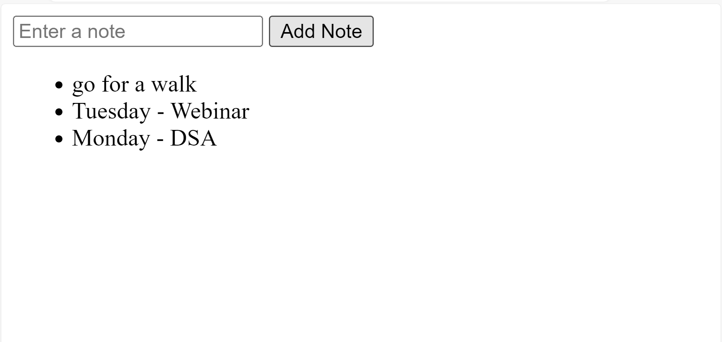
OUTPUT

Slide 5

THANK YOU

